Slide 1
Getting Started with Azure for Students
@bethanyjep
In-person event

Slide 2

Bethany Jepchumba
Cloud Advocate, Microsoft
Former Gold Microsoft Learn Student Ambassador
AI –ML and Academic (students and educators)
Microsoft Certified Trainer

Slide 3
Session Objectives
Understand Cloud Computing and its benefits
Understand Microsoft Azure and its offerings
Activate Azure for Students Credits.

Slide 4

There is no cloud
It's just someone else's computer🤫
Notes:
Have you ever wondered what cloud computing is? It's the delivery of computing services over the internet, which is otherwise known as the cloud. These services include servers, storage, databases, networking, software, analytics, and intelligence. Cloud computing offers faster innovation, flexible resources, and economies of scale.
To put it another way, cloud computing is a way to rent compute power and storage from someone else's datacenter. You can treat cloud resources like you would resources in your own datacenter. When you're done using them, you give them back. You're billed only for what you use.

Slide 5

Why should you move to the cloud?
Lower operations costs
Efficiency and effectiveness
Scalability on the go as you need to
Helps you to move, innovate and create faster
Limitless capabilities: raw compute, storage and networking

Slide 6
Introducing Microsoft Azure
Azure provides more than 100 services that enable you to do everything from running your existing applications on virtual machines, to exploring new software paradigms, such as intelligent bots and mixed reality.
Azure gives you the freedom to build, manage, and deploy applications on a massive global network using your favorite tools and frameworks.
Notes:
Continuous innovation from Microsoft supports your development today and your product visions for tomorrow.
Get security from the ground up, backed by a team of experts, and proactive compliance

Slide 7
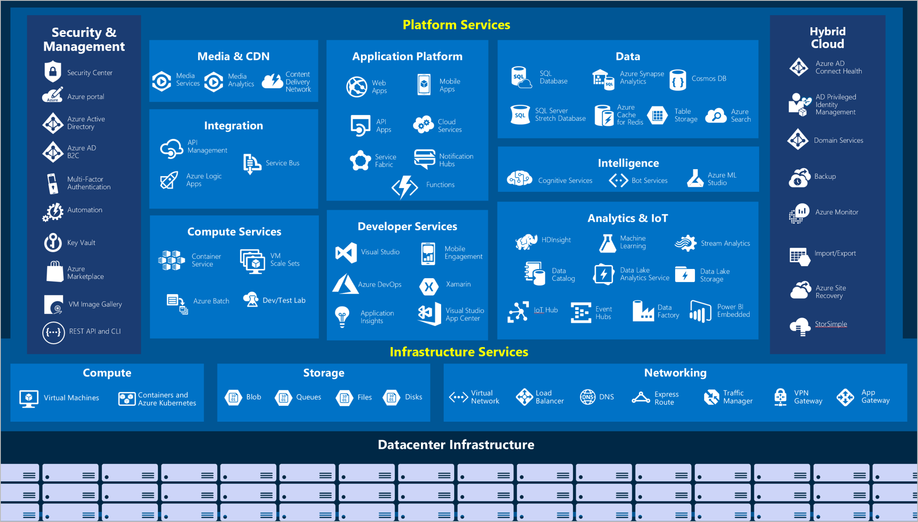
What can you do with Azure?

Slide 8
Azure for Students
Give students above 16 years access to:
$100 in Azure credits,
more than 25 free Azure Services,
access to downloadable Dev Tools & Learning Paths in one place.

Slide 9
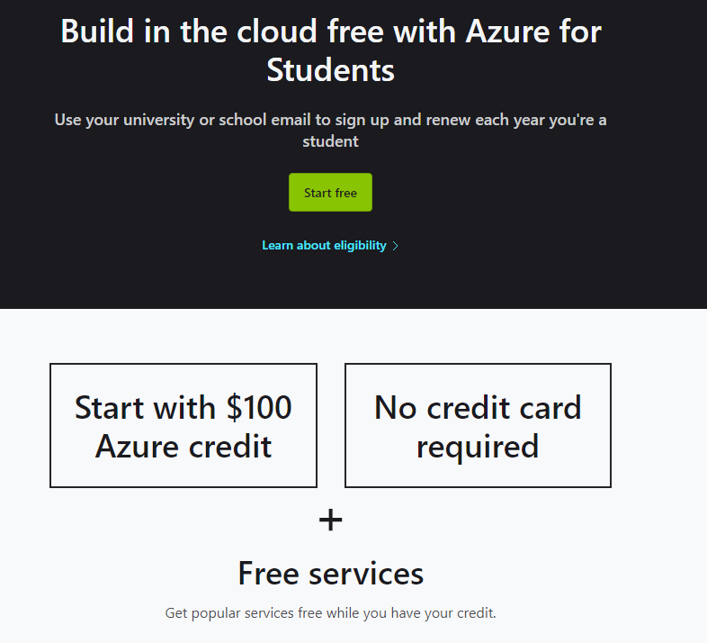
Let’s claim our benefits!!
Go to:
aka.ms/azure4student

Slide 10
Session Objectives.
Cloud Computing and its benefits
Microsoft Azure and its offerings
Access to Azure for Students Credits.

Slide 11

Resources and Next Steps
Explore Azure and more at https://aka.ms/learnstudent
Join the Microsoft Learn Student Ambassador Community at https://aka.ms/studentambassadors

Slide 12
Thank you!
@bethanyjep

